Slide 1
Prestressed Concrete
Lecture 1

Slide 2
Introduction
Prestressed concrete is concrete in which internal stresses of a suitable magnitude and distribution are introduced so that the stresses resulting from external loads are resisted.
The use of high-strength concrete and steel in prestressed members results in lighter and slender members than is possible with reinforced concrete.
There is an overall economy in using prestressed concrete, as the decrease in dead weight reduces the design loads and the cost of foundations.
It is a fact that the basic economy of prestressed concrete lies in its high strength to weight and strength to cost ratios, its resistance to fire and cracking, and its versatility and adaptability.
The observations which resulted from the research on prestressed concrete were:
1. Necessity of using high-strength steel and concrete.
2. Losses of prestress due to various causes.

Slide 3
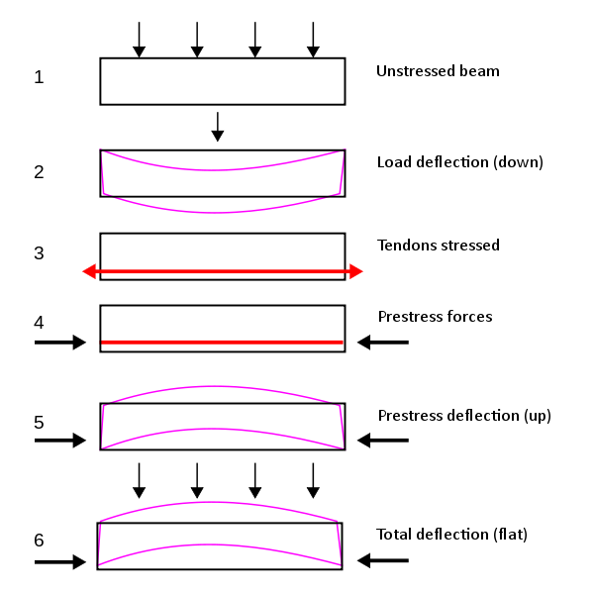
Prestressing Concept

Slide 4
PRESTRESSING METHODS
The various methods by which precompression is imparted to concrete are classified as follows: 1. Generation of compressive force between the structural element and its abutments using flat jacks. 2. Development of hoop compression in cylindrically shaped structures by circumferential wire winding. 3. Use of longitudinally tensioned steel embedded in concrete or housed in ducts. 4. Use of the principle of distortion of a statically indeterminate structure either by displacement or by rotation of one part relative to the remainder. 5. Use of deflected structural steel sections embedded in concrete until the hardening of the latter. 6. Development of limited tension in steel and compression in concrete by using expanding cement. The most widely used method for prestressing of structural concrete elements is longitudinal tensioning of steel by different tensioning devices.

Slide 5

Tensioning Devices
The various types of devices used for tensioning steel are grouped under four principal categories, namely:
1. Mechanical
2. Hydraulic
3. Electrical (thermal)
4. Chemical

Slide 6
Pre-Tensioning System

Slide 7
Long Line Pre-Tensioning System

Slide 8
Anchoring Devices

Slide 9
Principles of post-tensioning
In post-tensioning, the concrete units are first cast by incorporating ducts or grooves to house the tendons. When the concrete attains sufficient strength, the high-tensile wires are tensioned by means of jack bearing on the end face of the member and anchored by wedges or nuts. The forces are transmitted to the concrete by means of the end anchorages and, when the cable is curved, through the radial pressure between the cable and the duct. The space between the tendons and the duct is generally grouted after the tensioning operation.
Most of the commercially patented prestressing systems are based on the following principles of anchoring the tendons:
1. Wedge action producing a frictional grip on the wires.
2. Direct bearing from rivet or bolt heads formed at the end of the wires.
3. Looping the wires around the concrete.

Slide 10
Application of post-tensioning
Post-tensioning is ideally suited for medium to long-span in situ work where the tensioning cost is only a small proportion of the cost of the whole job. Hence, it is more economical to use a few cables or bars with large forces in each than many small cables or bars. Post-tensioning may be used with advantage to fabricate large members, such as long-span bridge decks of the box-girder type by prestressing together several smaller precast units.
Post-tensioning is invariably used for strengthening concrete dams, circular prestressing of large concrete tanks and biological shields of nuclear reactors.

Slide 11
Tendon Splices
In the case of continuous prestressed concrete members involving long tendons, it is necessary to splice the tendons to achieve continuity.

Slide 12
What are Reinforced and Prestressed Concrete differences?
RCC | PSC
The concrete in the compression side of the neutral side of the axis of RCC beam is only effective and the concrete in the tension side of the neutral axis is ineffective | The entire section of the prestressed concrete is effective
RCC beams are heavy | PSC beams are usually lighter
High strength concrete is not needed | In PSC beams, high strength concrete and high strength steel are necessary
RCC beams are desirable where the weight is more desired than strength | PSC beams are suitable for heavy weight and durability

Slide 13
What are RCC and PSC differences?
Reinforced Concrete Prestressed Concrete
Fatigue limit is low. The fatigue limit is high.
It gets deformed more than PSC. It deforms less than RCC.
The product price to manufacture RCC concrete is low. The product price to manufacture
prestressed concrete is high.
Deformed bars and mild steels are High-quality tendons are used.
inserted in RCC concrete.
Internal stress is not introduced in RCC. In prestressed concrete internal stress is
introduced prior to loading.
Tensile cracks can be seen. Tensile cracks are not seen.
RCC concrete doesn't need quality control. Good quality control and skilled labor
are required.
Shear reinforcement is required. Tendons help to resist the shear reinforcement.
High strength is not needed in RCC. High strength is required in prestressed
concrete.
Steels cannot be tested in RCC. Steels can be tested in prestressed concrete by
placing them inside.
Needed for construction of the building. Needed for construction of railways, sleepers,
bridges, and gravity dams.

Slide 14
What is the difference between RCC and PCC?
*Concrete in the compression side of the neutral side of the axis alone is sufficient in RCC beams. It is useless to place concrete on the neutral axis' tension side. However, in a prestressed concrete beam, the entire portion is functional.
*In general, reinforced concrete beams weigh a lot. They usually require shear reinforcements in addition to longitudinal reinforcement for flexure. The beams made of prestressed concrete weigh less. A significant portion of the shear is resisted by the pre-compression and the curved tendons.
*It is not necessary to use high-strength concrete in reinforced concrete beams. However, high-strength steel and concrete are required for prestressed concrete beams. For the anchorages to withstand significant forces, highly durable concrete is required. To transfer a significant amount of prestressing force, high-strength steel is necessary.
*There is no means to test the steel and the concrete in reinforced concrete beams. Steel and concrete can be tested in prestressed concrete beams while they are being prestressed.
-These are a few points of difference between prestressed and reinforced concrete.

